Slide 1
Highways and words: Does transience predict cultural diversity?
Anjali Bhatt & Molly Lewis
June 30th, 2017
Summer Institute in Computational Social Science

Slide 2
Motivation
Methods
Findings
Next Steps

Slide 3
Motivation
Methods
Findings
Next Steps

Slide 4
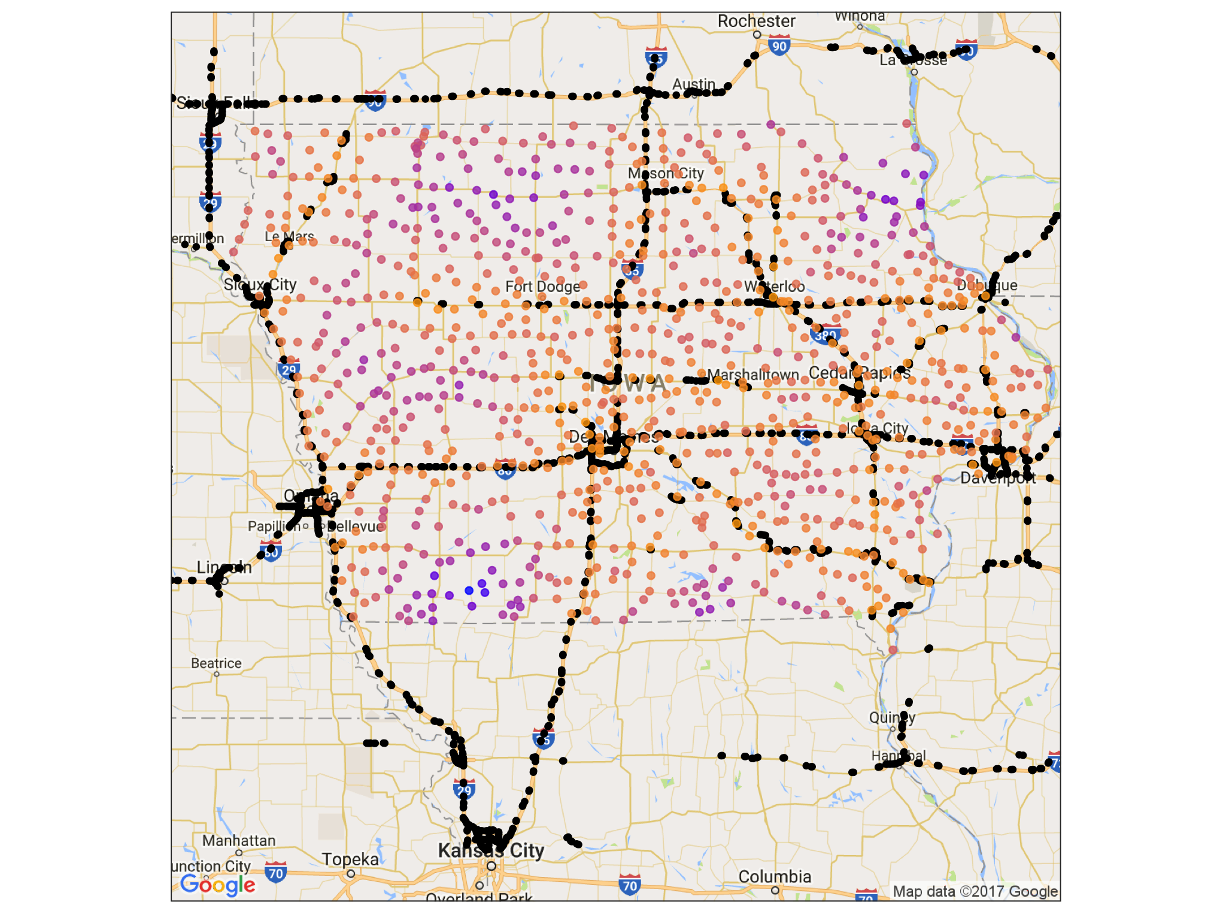
Highway Proximity
Highway exits from OpenStreetMap (includes nearby exits outside of Iowa)
946 incorporated cities in Iowa, excluding Des Moines
Driving time to highway ranges from 2 to 83 min (median of 20 min)

Slide 5
Google Reviews
Fetch all reviews for establishments within a 5km radius of city centers
24,469 total reviews
Retain 546 cities with at least 5 reviews

Slide 6
Motivation
Methods
Findings
Next Steps

Slide 7
Linguistic Features
Review length
Capitalization
Emoji use
Punctuation
Sentiment

Slide 8
Lexical Diversity
xxx

Slide 9
Motivation
Methods
Findings
Next Steps

Slide 10
Appendix

Slide 11
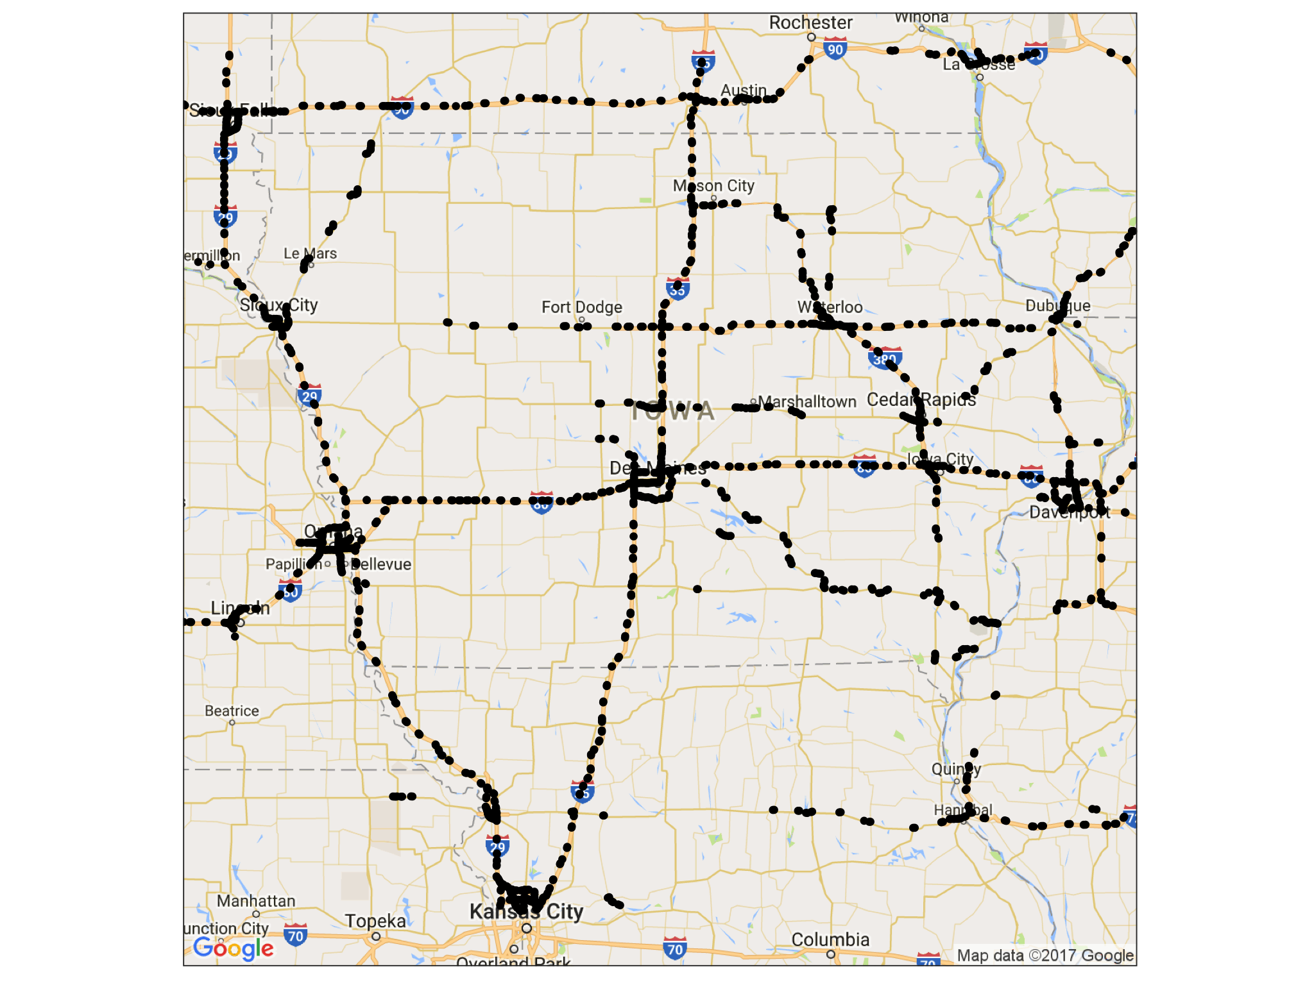
Highway Exits

Slide 12
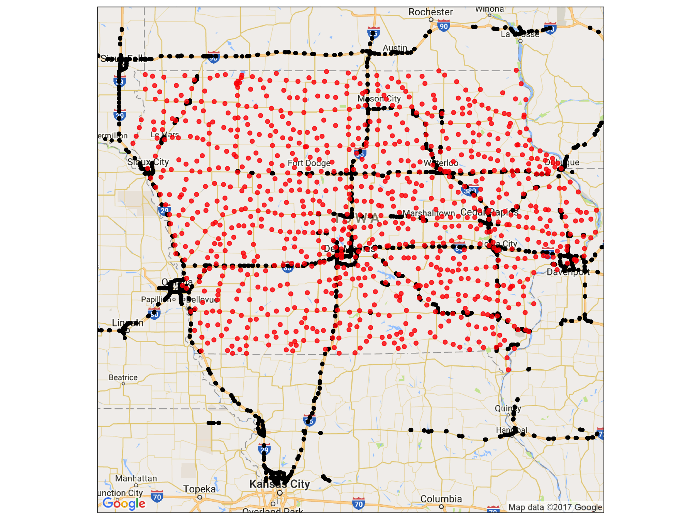
Towns in Iowa

